Slide 2
learn big data management and processing using datameer

Slide 3

Introduction

Slide 4
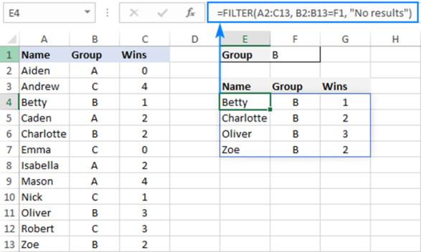
Introduction

Slide 5
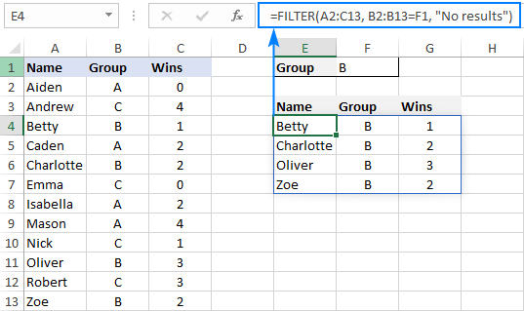

Introduction

Slide 6
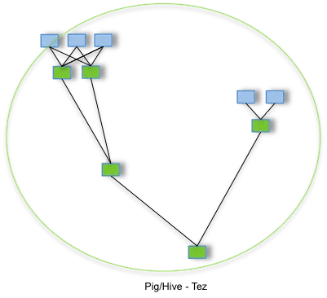
Introduction
Splitting up workloads into smaller pieces.

Slide 7
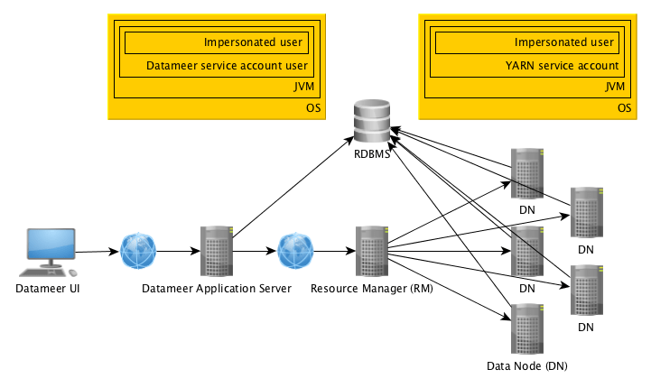
Introduction

Slide 8
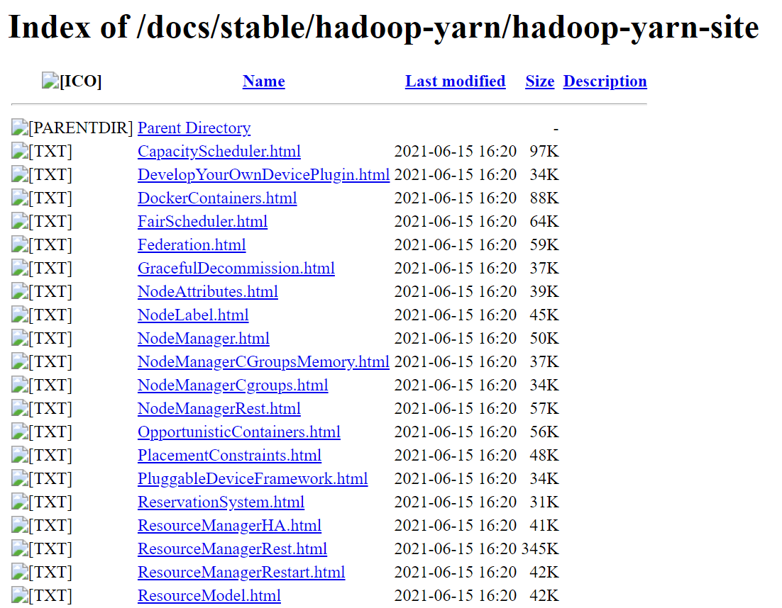
Introduction
Scheduling settings and use resources

Slide 9
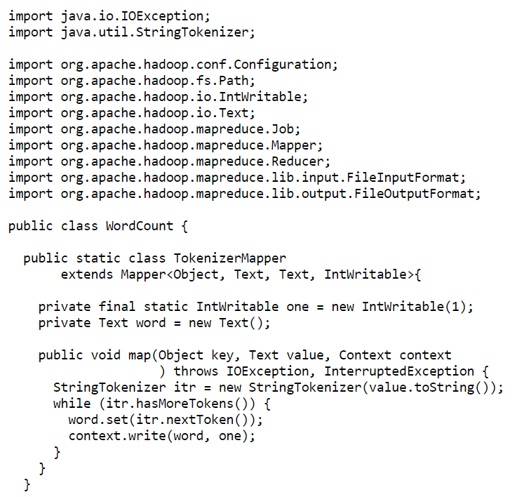
Introduction
Java program for distributed computing on the cluster backend.

Slide 10

Introduction
Datameer such an outstanding technology.

Slide 11
Introduction
data types
memory
disk usage

Slide 12
Introduction
Analytics work into two stages
Design/edit time
Execution/runtime

Slide 13


DESIGN/EDIT TIME

Slide 14
DESIGN/EDIT TIME
<datameerServiceAccountUser>@<datameerHost>
or
<loggedinUser>@<datameerHost>.

Slide 15
EXECUTION/RUN TIME
Random DataNodes (DN) in the cluster

Slide 16
EXECUTION/RUN TIME
Random DataNodes (DN) in the cluster

Slide 17
EXECUTION/RUN TIME
<yarnServiceAccountUser>@<dataNode>
or
<impersonatedUser>@<dataNode>.

Slide 18
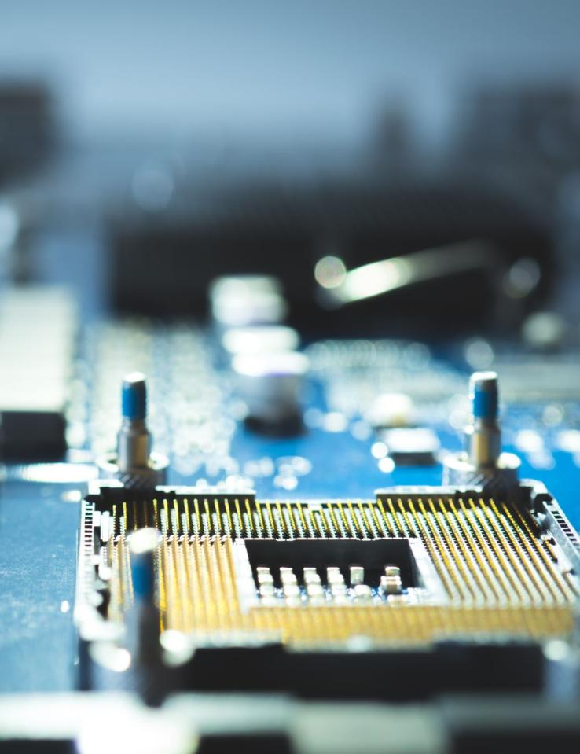
What is Data Preparation and Feature Engineering

Slide 19

cleaning,
structuring,
enriching raw data,
unstructured or big data.

Slide 20
Data Preparation in Datameer

Slide 21
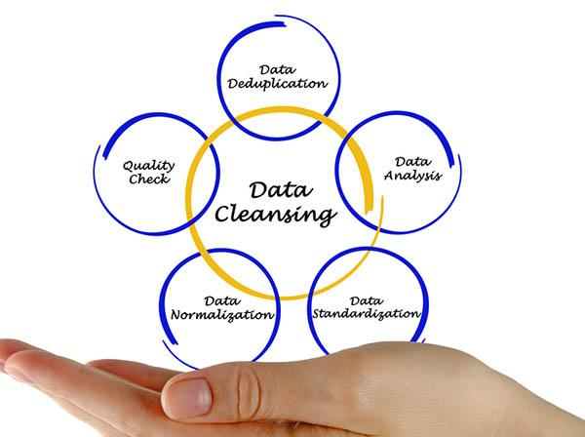
Data Cleansing

Slide 22
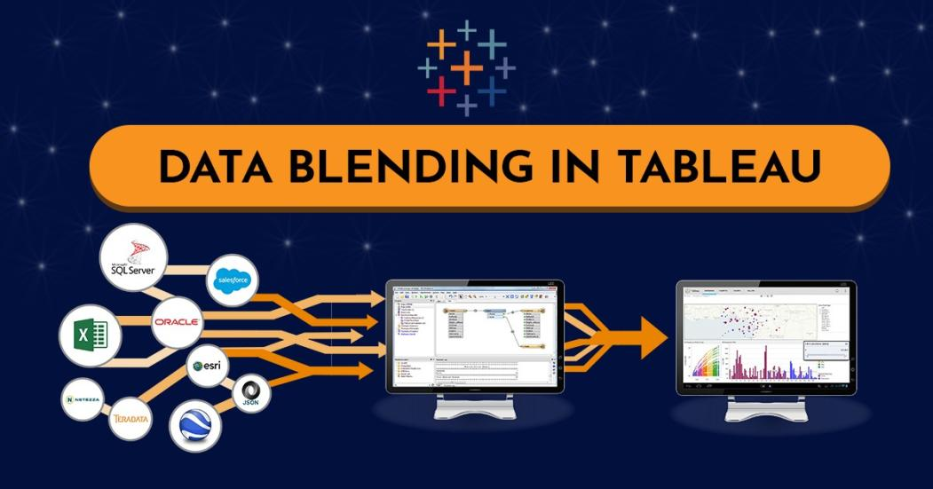
Data Blending

Slide 23
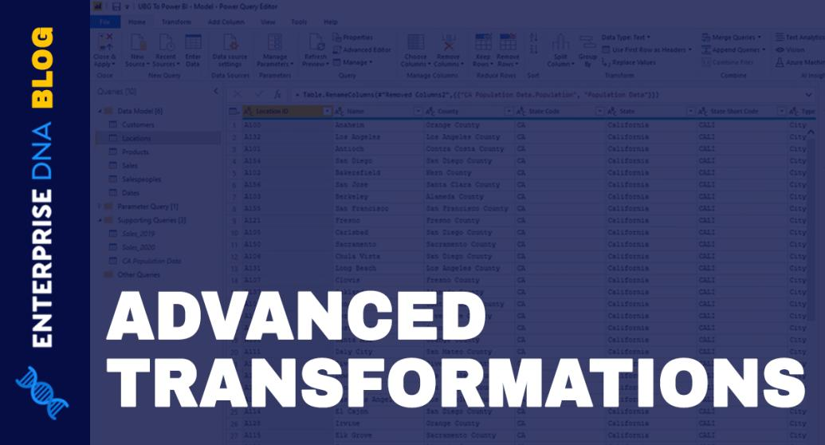
Data transformations

Slide 24
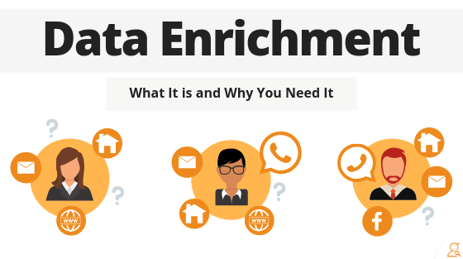
Data enrichment

Slide 25
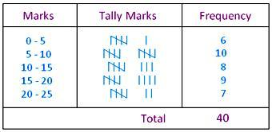
Data grouping and organization

Slide 26
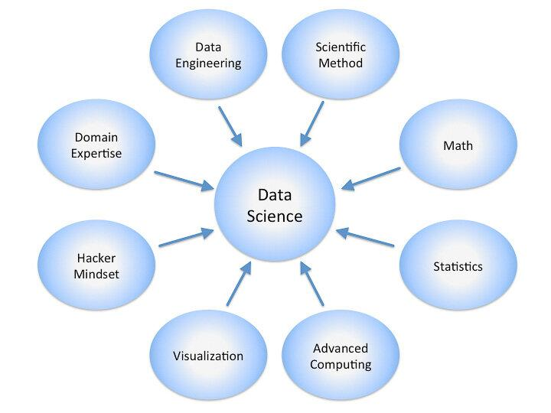
Data science-specific

